Slide 1

Arabic AI-Text Detection using Apache Spark
By: Abdulaziz Hasan Aljohani

Slide 2

Introduction
Developed a scalable pipeline to distinguish human-written from AI-generated Arabic abstracts.
Utilized Apache Spark for distributed processing of massive text datasets.
Combined TF-IDF semantic vectors with custom stylometric features.
Implemented Real-time Stream Processing simulation

Slide 3
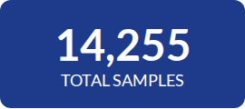
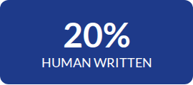
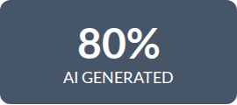
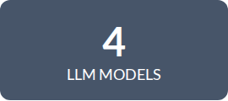
Dataset
Key Sources
AI samples generated using 4 state-of-the-art models:
Allam & Jais (Arabic Centric)
Llama & OpenAI (General Purpose)

Slide 4
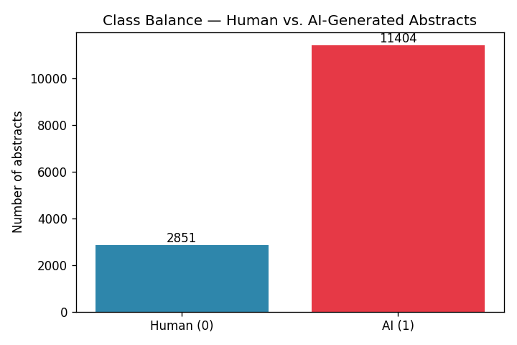
Expletory Data Analysis
Class Balance
Human 20%
AI 80%

Slide 5
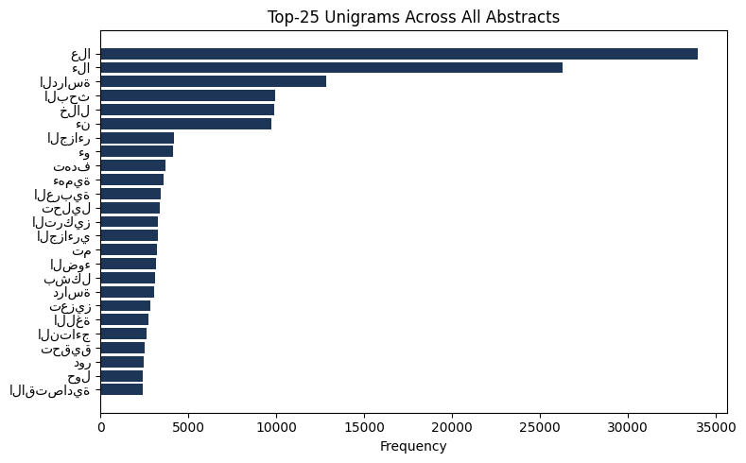
Expletory Data Analysis
Top-25 Unigrams Across All Abstracts

Slide 6
Distributed Preprocessing
Arabic Text Cleaning
Normalization: Unified Alef/Hamza and removed diacritics using pyarabic.
Stopwords: Broadcasted 701 Arabic stopwords for efficient filtering.
Tokenization: Segmented text into meaningful units, ignoring short tokens.
Storage limitation: Optimized via Parquet columnar format for Big Data.

Slide 7
Feature Engineering
Stylometric Features
f011: Ratio of long words (>6 chars) to total words.
f034: Physical line count analysis.
Global Features
TF-IDF: 4,096-dimensional semantic embedding capturing word importance across the corpus.

Slide 8
Batch Modeling Results
Model | Accuracy | F1-Score | AUC | Train Time
Logistic Regression | 0.9435 | 0.9424 | 0.9786 | 8.75s
Naive Bayes | 0.8949 | 0.9009 | 0.6229 | 2.15s
Random Forest | 0.8130 | 0.7310 | 0.9706 | 13.19s
Insight: Logistic Regression outperformed others, balancing precision and recall effectively.

Slide 9
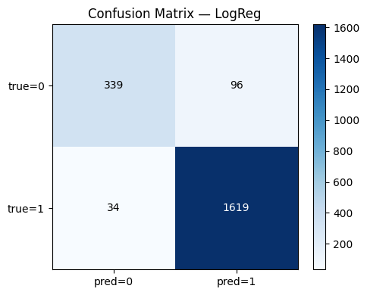
Confusion Matrix
The model shows high precision for AI detection (1619 correct vs. 34 false positives). It struggles more with false negatives (96 human samples misclassified as AI), indicating a slight bias towards the majority class, which is common in imbalanced datasets

Slide 10
Streaming
Simulation: JSON file-based stream source to mimic production input.
Spark Structured Streaming: Unified API for processing live data.
Consistency: Shared preprocessing pipeline between batch and stream.
Result: Achieved 100% accuracy on simulated test batches.

Slide 11
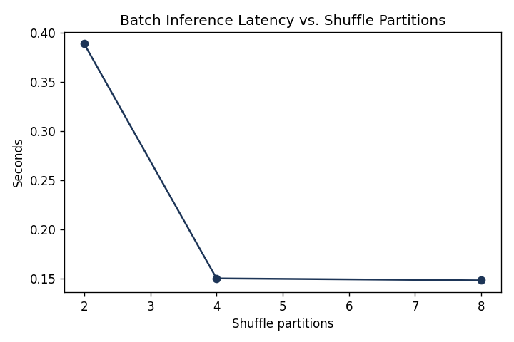
Performance & Scalability
The Power of Parallelism
Inference time on test set (2,088 samples):
2 Partitions: 0.389s
4 Partitions: 0.150s
8 Partitions: 0.148s

Slide 12
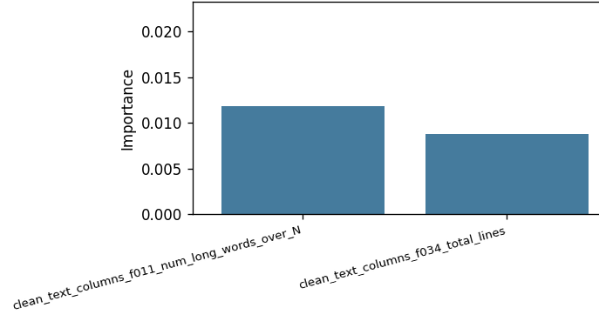
Feature Importance
The Power of Parallelism
Feature 11 is more important than Feature 34

Slide 13
Conclusion & Future Work
This project apply complete, scalable big data pipeline for Arabic AI-text detection. The Logistic Regression model, trained on a combination of TF-IDF and simple stylometric features, achieved strong performance (F1 > 0.94) despite the dataset's imbalance. The implementation of a file-based stream processor validates the architecture's readiness for real-time or near-real-time applications in a production environment

Slide 14
Conclusion & Future Work
Future work
Hybrid Models: Integrate AraBERT for deep semantic understanding.
Attribute Classification: Identify which model generated the text.
Multi-domain: Expand to social media and news detection.

